Slide 1

Forecasting School Meal Production Costs: A Comparative Study of Machine Learning and Deep Learning Time-Series Models
Team Members:
Areena
Varshith Reddy Bhimireddy
Chaya Chandana Doddaiggaluru Appajigowda
Institution: George Washington University
Supervisor: Amir Jaffari
Goal: Predict production_cost_total to enable efficient meal planning and waste reduction in schools.

Slide 2

Problem Statement
Schools struggle to predict daily meal preparation quantities.
Inaccurate forecasts lead to food waste and increased production costs.
Traditional methods, relying on manual estimates, are often unreliable.
Accurate forecasting supports sustainable operations and efficient budget management.
This project employs LSTM/GRU models to enhance cost prediction accuracy.

Slide 3
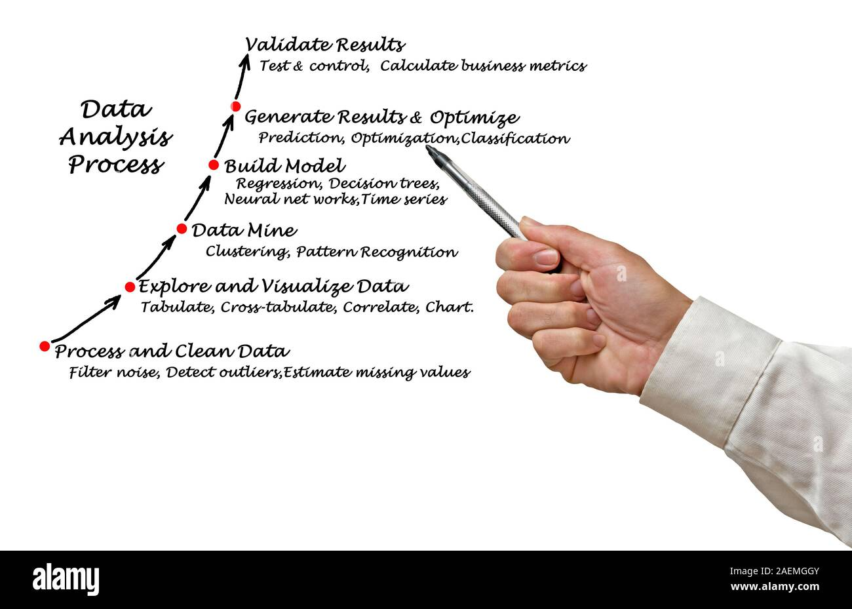
Data Preparation
Source: 100+ FCPS HTML meal production reports
Parsing via BeautifulSoup → structured CSVs
Cleaned currency/percentage fields, filled missing values
Removed outliers using IQR and 99th percentile filtering
Final dataset: 177,492 records with daily cost and operational metrics

Slide 4
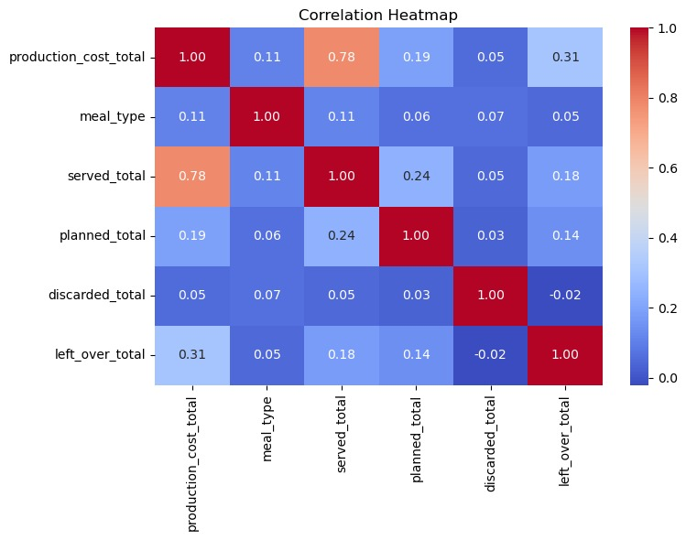
Exploratory Data Analysis (EDA)
Strong correlation: served_total ↔ production cost (r = 0.78)
Moderate correlation: leftover_total (r = 0.31)
Weak/no correlation: discarded_total, meal_type
No multicollinearity: VIF values < 1.3; SVD confirms good conditioning

Slide 5
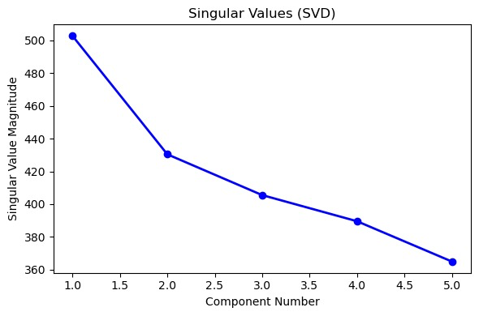
VIF and SVD Check
Variance Inflation Factor (VIF) Scores ===
Feature VIF
0 meal_type 1.265688
1 served total 1.284747
3 discarded2 planned_total 1.157264
_total 1.028817
4 left_over_total 1.137335
SVD Collinearity Analysis ===
Singular Values:
[502.77877511 430.43532632 405.52377947 389.56110241 364.94731802]
No strong collinearity detected (all singular values are large).

Slide 6

Model Architecture
Goal: Predict next-day production cost using time-series data.
Approaches:
Univariate — Uses only past cost values
Multivariate — Uses cost + Served, Planned, Discarded, Leftover
Technique:
Sliding-window (W = 3)
Forecast: Cost(t+1) from past 3 days
Models:
LSTM – best for long-term patterns
GRU – fast, efficient alternative
FNN, XGBoost, Linear Regression – benchmarks
Train/Test Split:
60% train, 20% val, 20% test

Slide 7
Evaluation Metrics
Multivariate Model Performance
Univariate Model Performance
Model | MSE | RMSE | R2
Linear Regression | 39013.54 | 197.52 | 0.75
XGBoost | 39595.32 | 198.99 | 0.74
FNN | 39241.72 | 198.10 | 0.75
LSTM | 18793.44 | 137.08 | 0.86
GRU | 20186.30 | 142.07 | 0.85
Model | MSE | RMSE | R2
Linear Regression | 39013.54 | 197.52 | 0.75
XGBoost | 39595.32 | 198.99 | 0.74
FNN | 39241.72 | 198.10 | 0.75
LSTM | 18793.44 | 137.08 | 0.86
GRU | 20186.30 | 142.07 | 0.85
Insight:
GRU gave the lowest error (MSE & MAE), while LSTM achieved highest accuracy (R² = 0.81)
Insight:
In univariate forecasting, LSTM performed best overall, followed closely by GRU

Slide 8
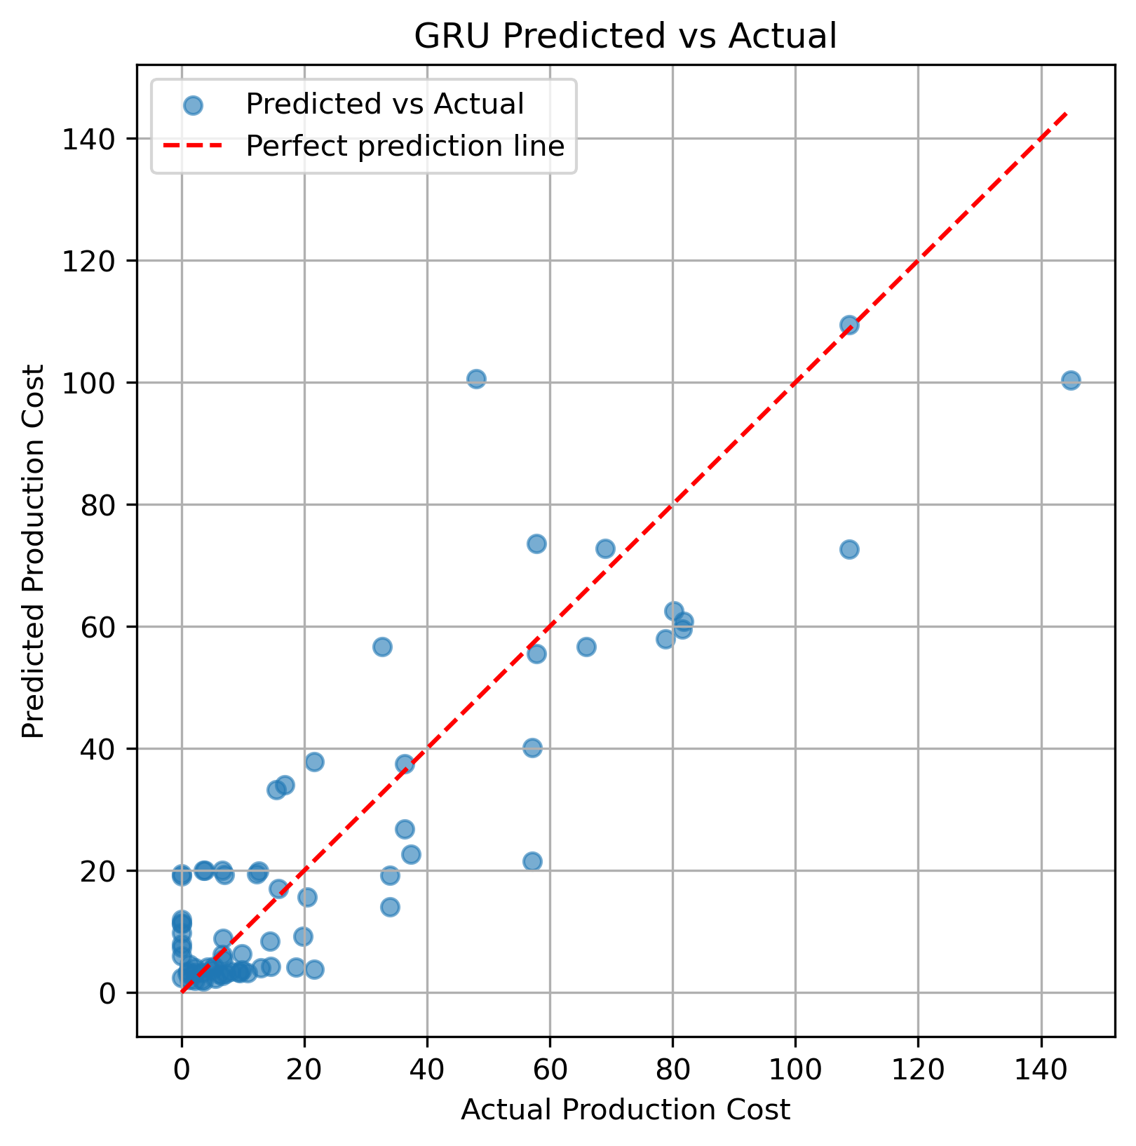
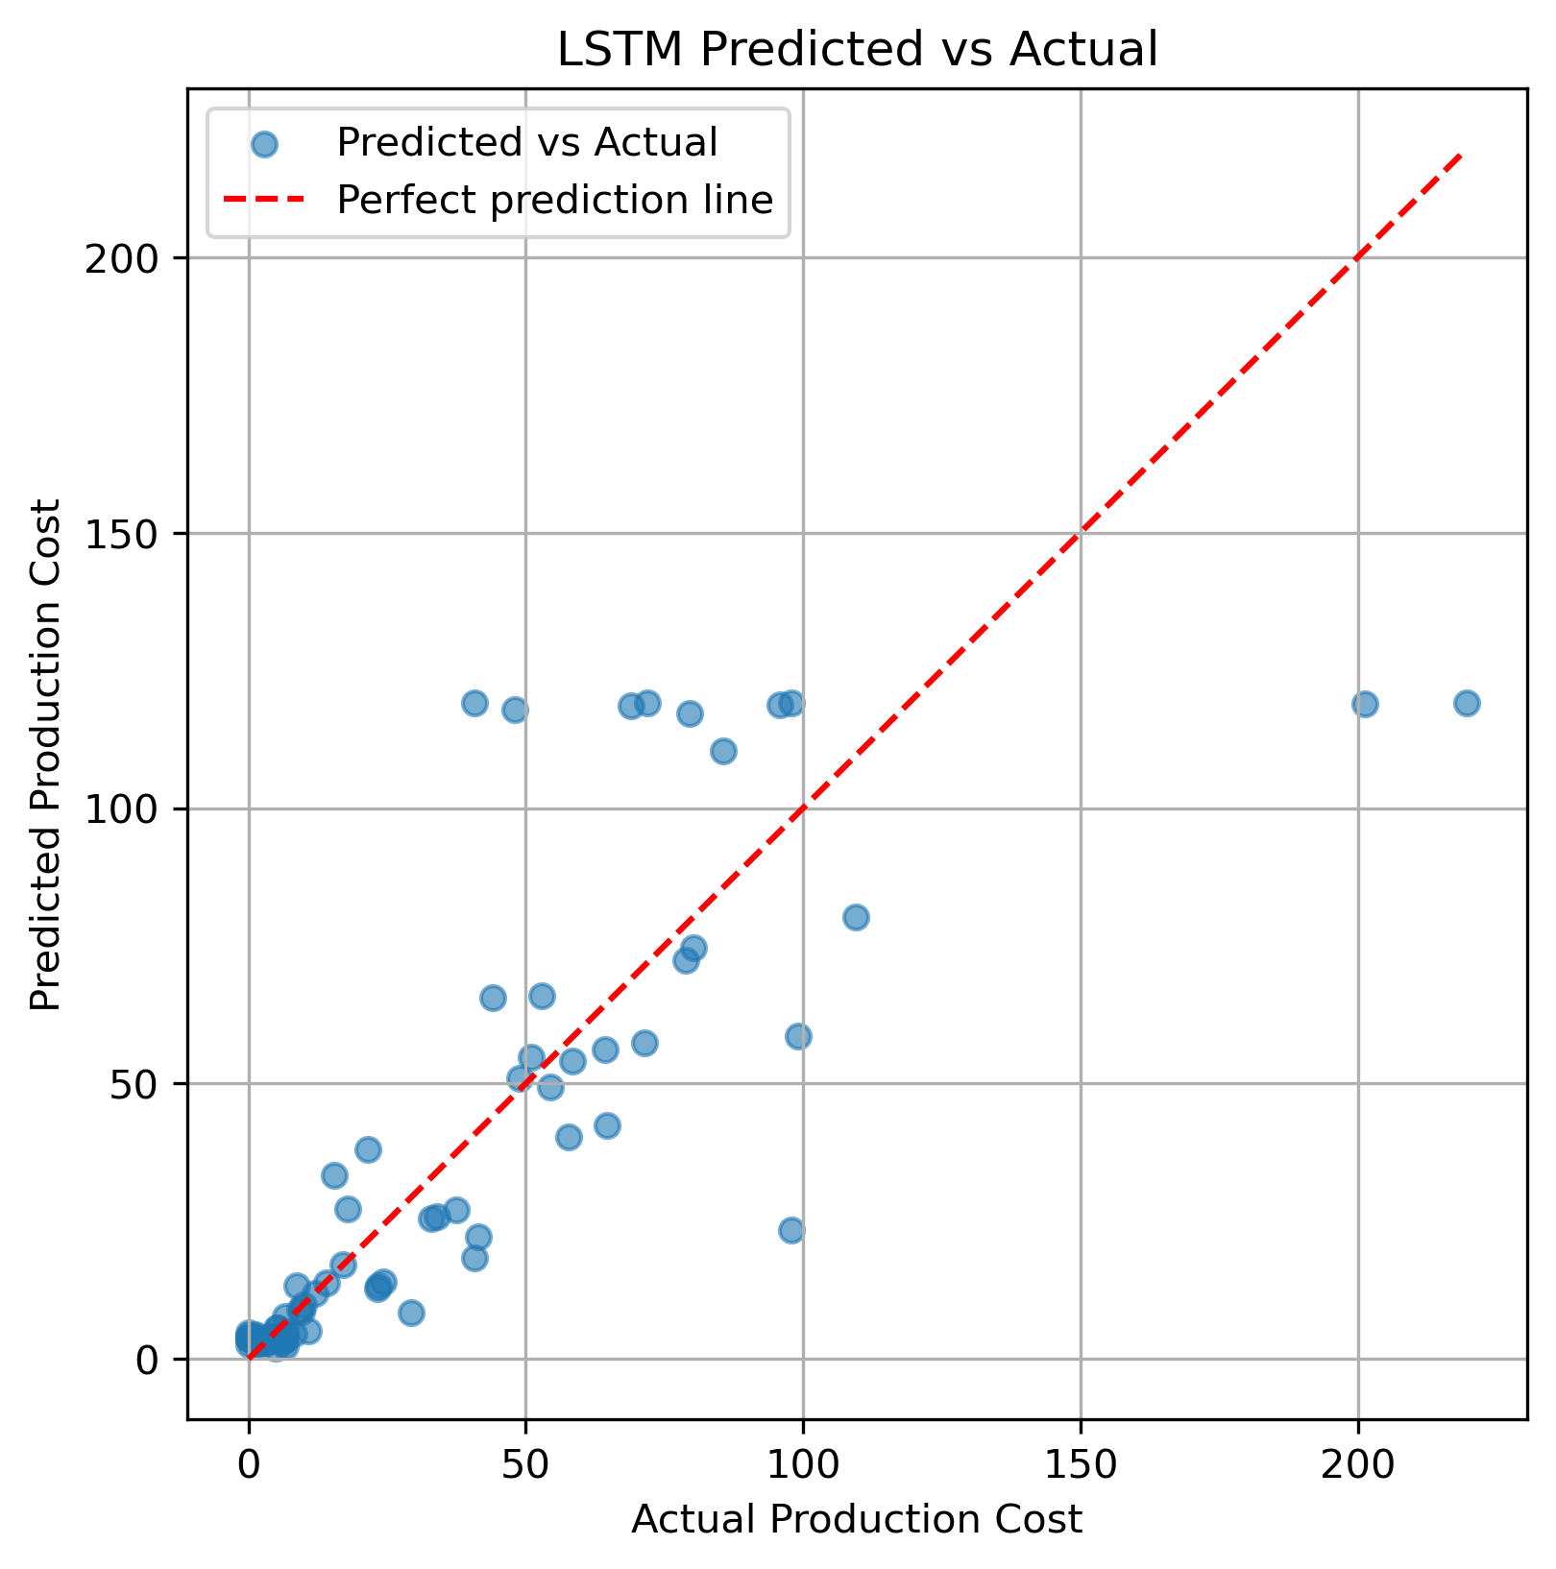
Multivariate Plots:
LSTM:
• Most predictions are close to the actual values
• Performs well even for higher production costs
• Slightly more scattered, but shows good overall accuracy
GRU:
• Predictions closely follow actual values, especially at low cost ranges
• Tighter clustering around the perfect line
• More stable for smaller-scale forecasts

Slide 9
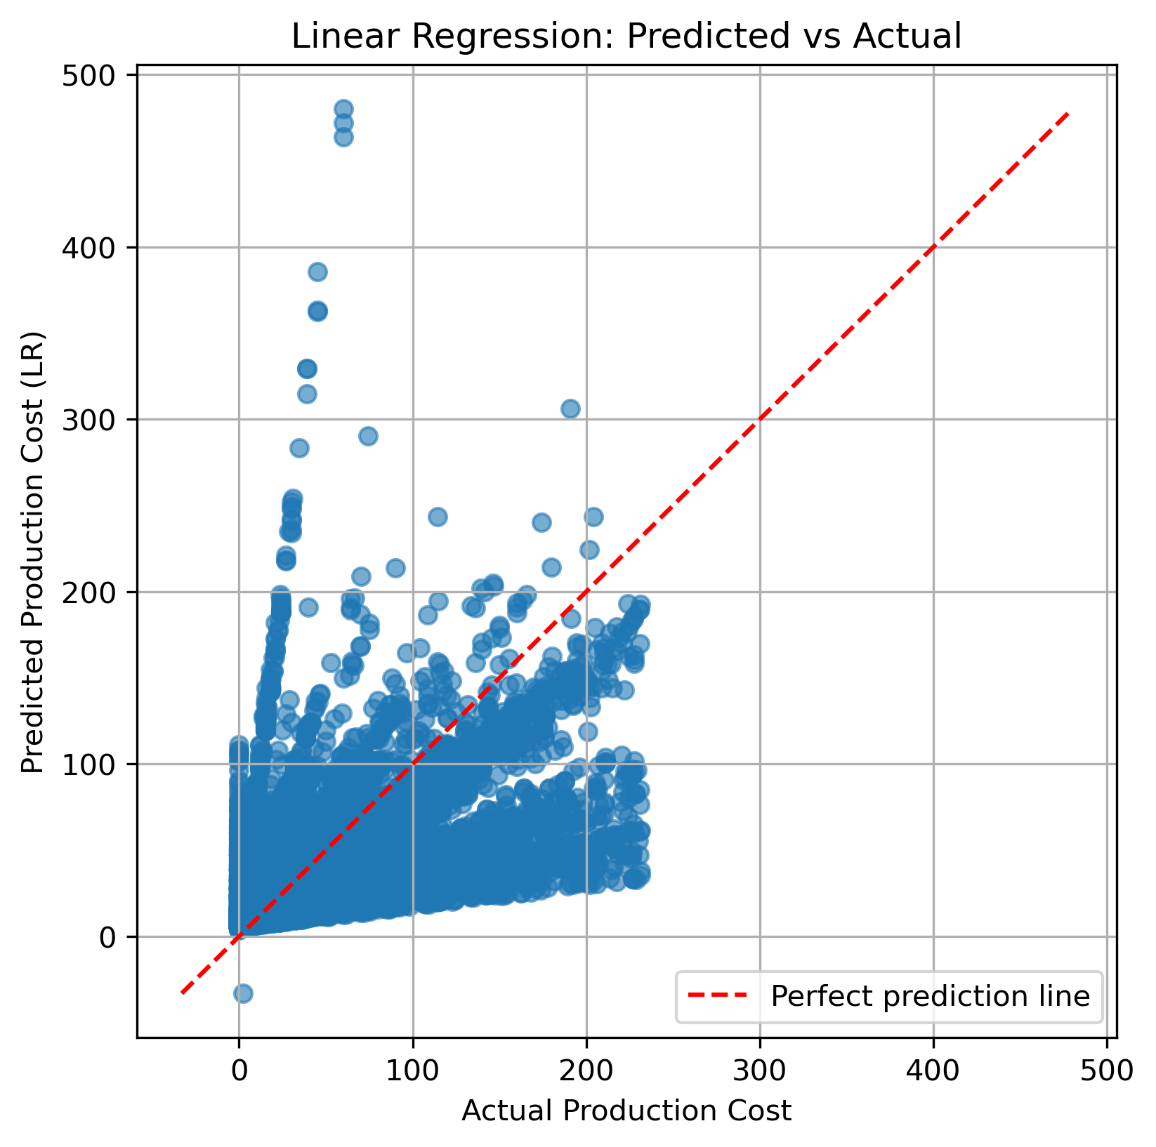
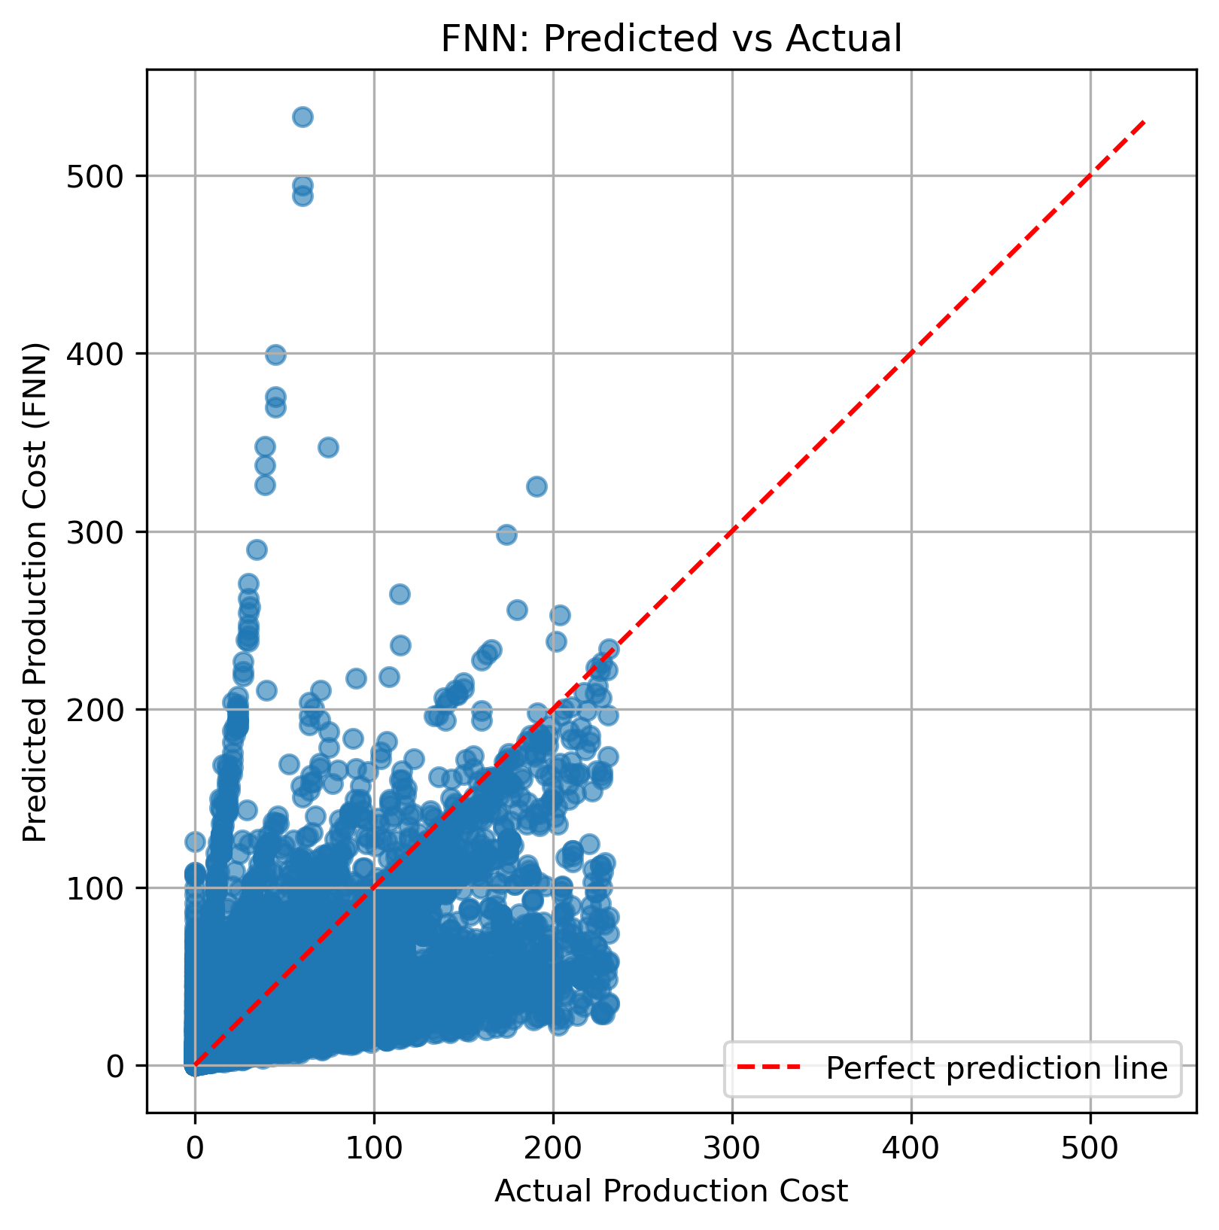
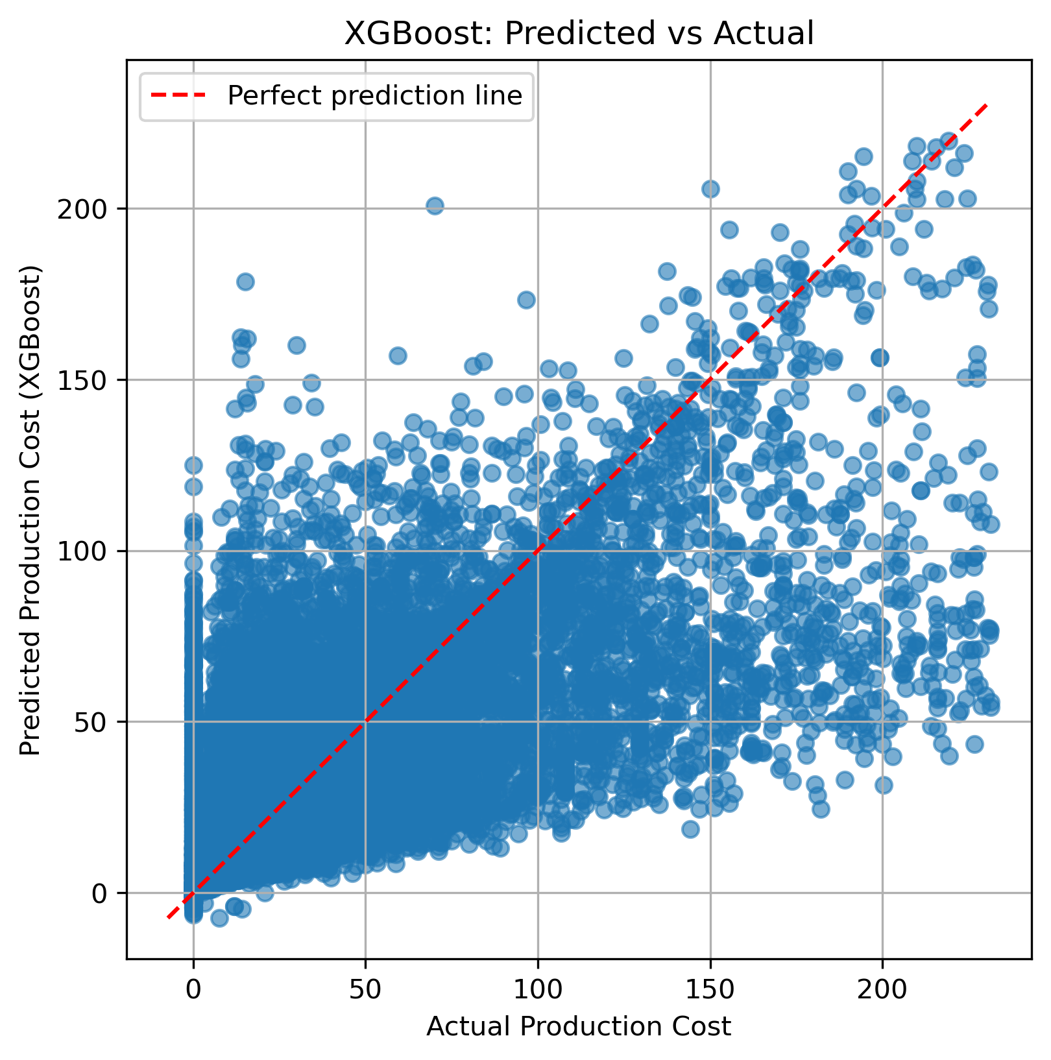
FNN:
• Predictions are widely scattered around the ideal line
• Model struggles to capture time-dependent cost trends
• Less accurate compared to LSTM and GRU
• Performs decently for average costs, but poor at high-cost predictions
XGBoost:
• Predictions follow the general trend but with high variance
• Performs better than Linear Regression and FNN
• Struggles with higher cost values — more scattered
• Lacks sequence-awareness, limiting forecasting precision
Linear Regression:
• Predictions are highly scattered, especially at higher costs
• Model fails to follow the ideal prediction line
• Can't capture nonlinear or time-based cost patterns
• Performs poorly compared to deep learning models

Slide 10
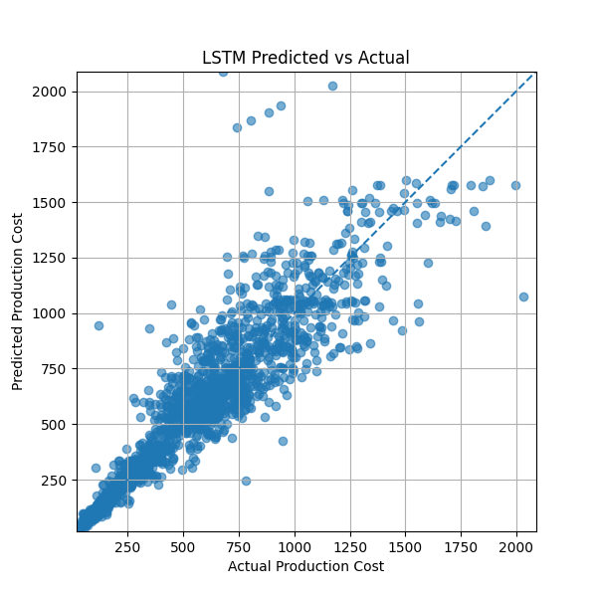

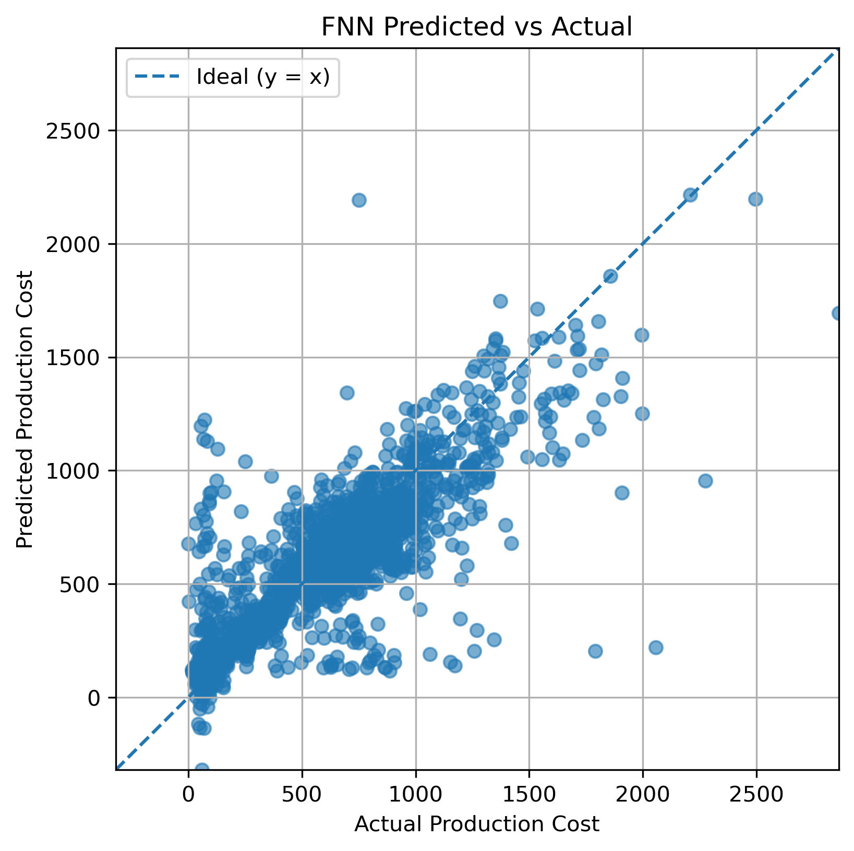
Univariate Plots:
FNN:
• Predictions follow the general trend but with noticeable scatter
• Performs well in mid-range values, less consistent at extremes
• Lacks memory of past values — weaker on time-series patterns
• Accuracy lower compared to LSTM/GRU, but better than Linear Regression
GRU:
• Align closely with actual costs, especially at higher ranges
• Points are tightly clustered along the diagonal → strong accuracy
• Handles complex patterns across schools and meal types well
• Reliable for both small and large-scale forecasting
LSTM:
• Predictions closely follow actual values across the full range
• Slightly more scattered than GRU but still concentrated near the ideal line
• Captures complex temporal trends effectively
• Strong overall performance for production cost forecasting

Slide 11
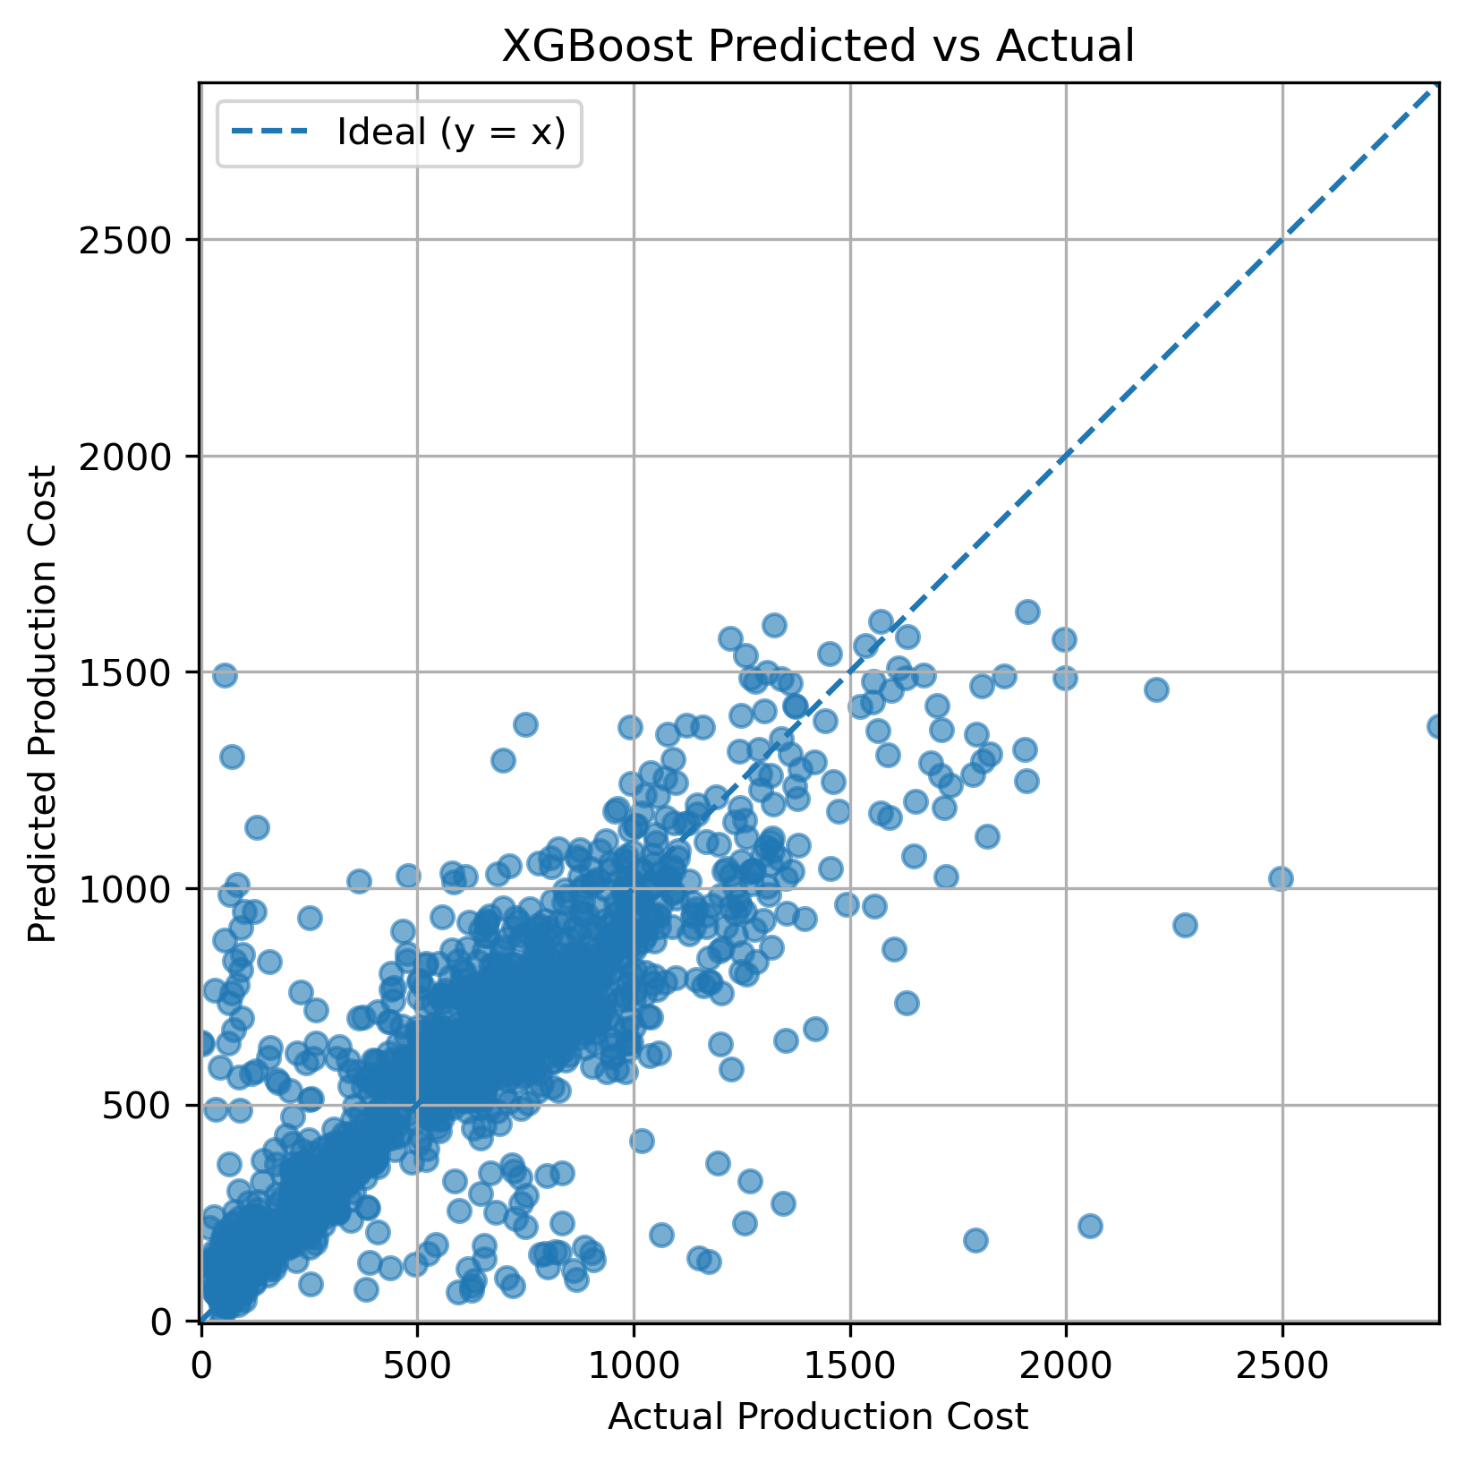
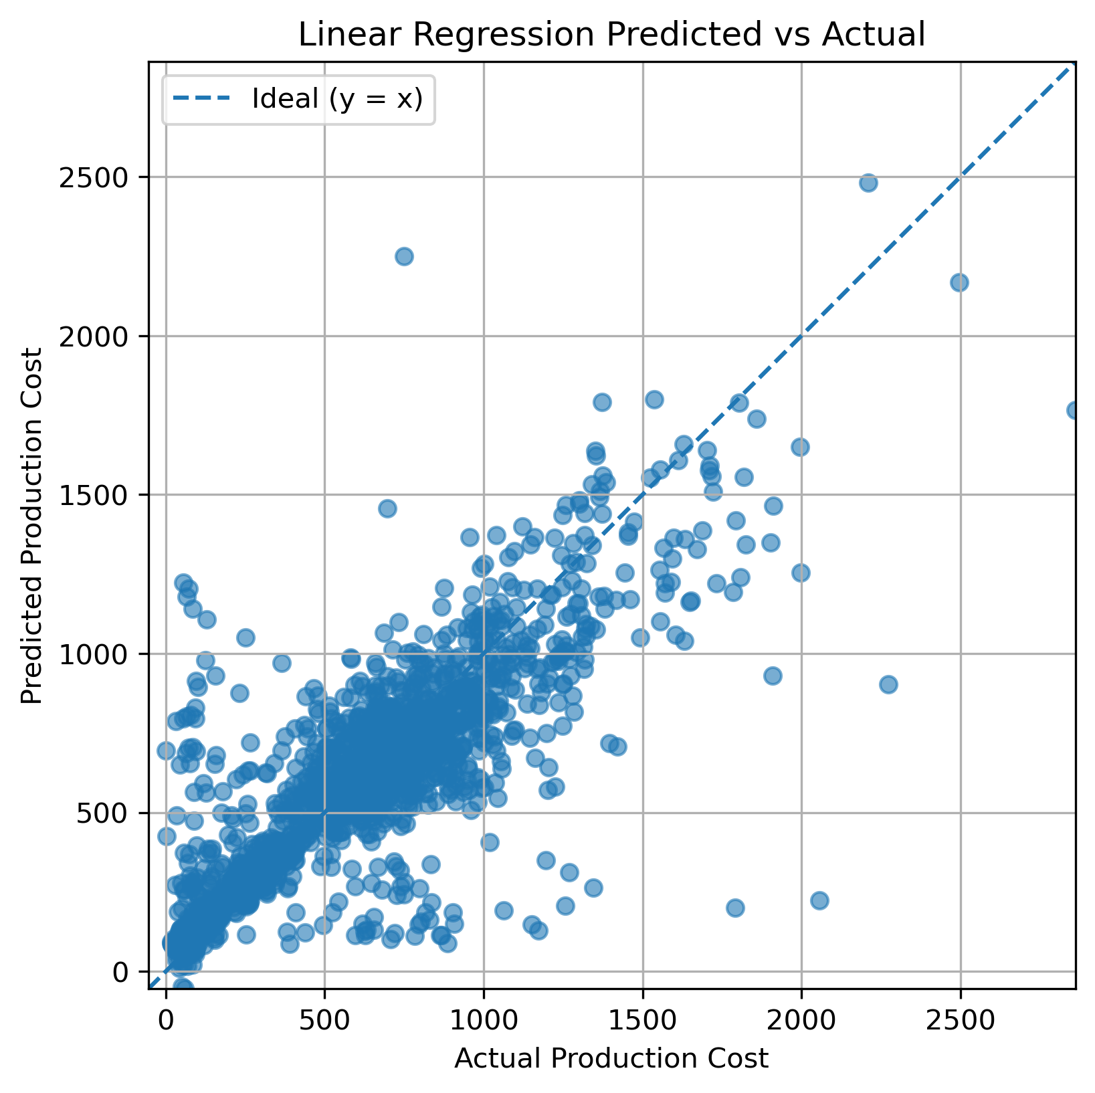
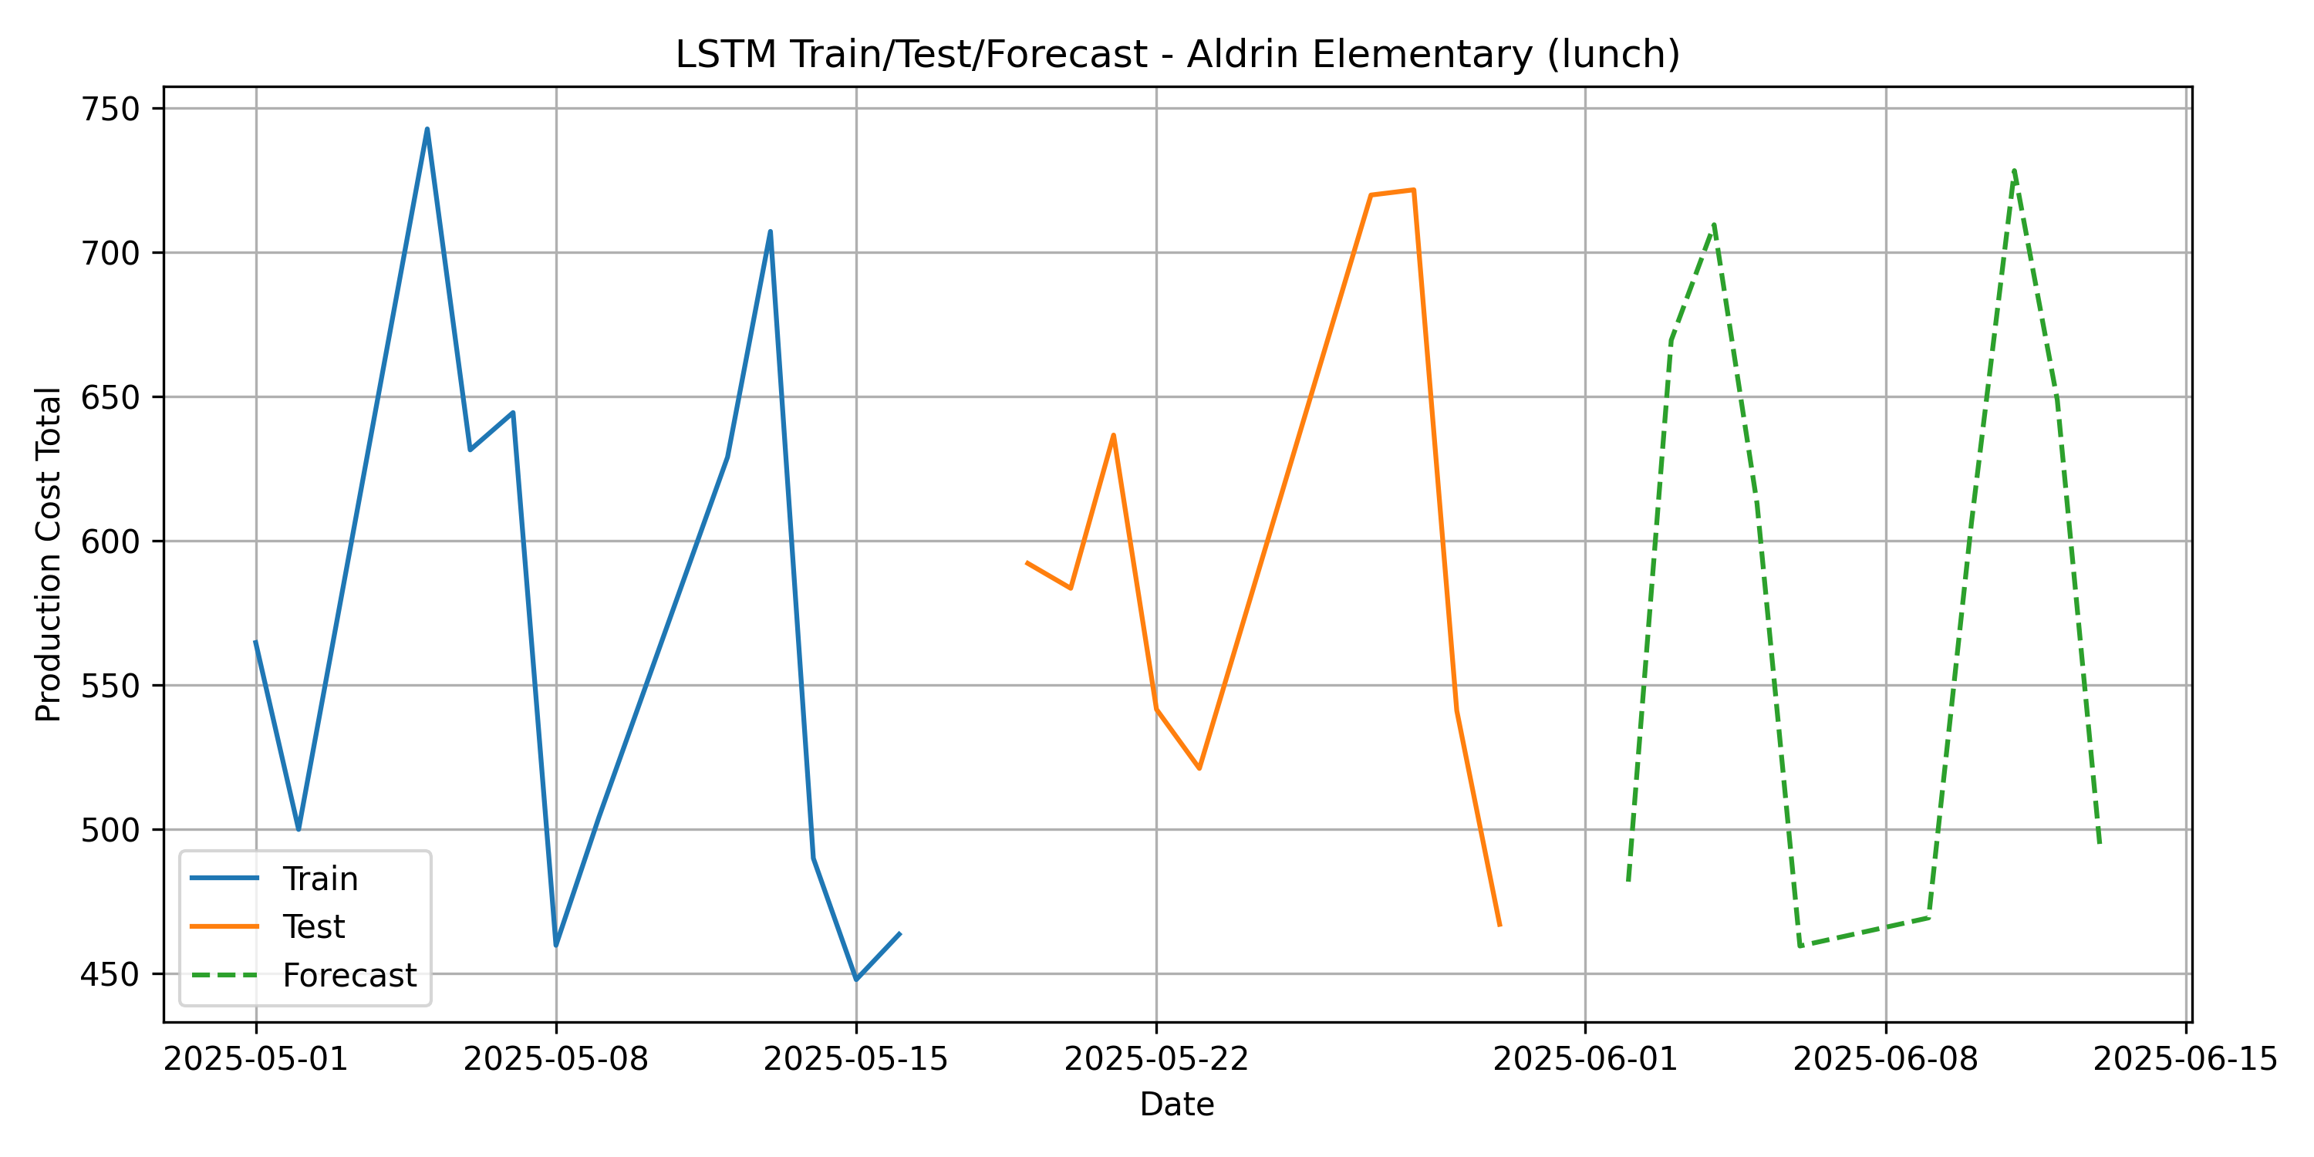
Linear Regression:
• Captures general trend but shows high error at both ends
• Predictions are widely spread, especially for higher costs
• Lacks ability to learn complex or nonlinear patterns
• Performs the weakest among all evaluated models
LSTM Train/Test:
• Blue: training data, Orange: test data, Green: future forecast
• Forecast continues learned patterns from past data
• Shows realistic trends in daily production cost
• Confirms LSTM captures school-specific cost behavior over time
XGBoost:
• Follows the actual cost trend fairly well
• Better performance than Linear Regression and FNN
• Some spread in predictions at high cost values
• Lacks temporal learning, so accuracy dips on complex patterns

Slide 12
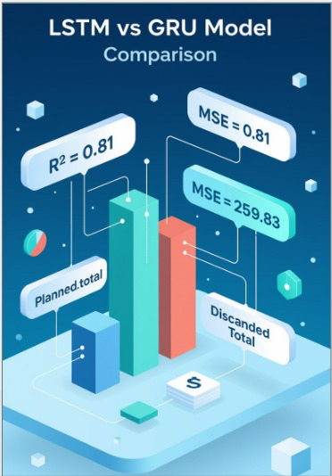
Key Findings
LSTM consistently outperformed other models with highest accuracy:
R² = 0.81 (Multivariate) and R² = 0.86 (Univariate)
Strong at capturing long-term temporal patterns
GRU showed lowest error (Multivariate) and competitive accuracy:
Faster training than LSTM, good for near real-time needs
XGBoost and Linear Regression underperformed, especially with time-series dependencies
Feature Insights:
Served_total and Planned_total had the highest impact on cost
Discarded_total highlighted inefficiencies and food waste
Data Quality:
No multicollinearity found (VIF < 2)
Outcome:
Enables accurate cost forecasting, waste reduction, and budget optimization for school meal programs

Slide 13

Conclusion
This project successfully developed a forecasting system for school meal production costs using advanced time-series models.
Among all models, LSTM and GRU delivered the best performance, capturing temporal trends and cost patterns effectively.
The use of multivariate features (served, planned, discarded meals) significantly improved prediction accuracy.
Model results support data-driven decision making for reducing waste, improving planning, and optimizing budgets in public school meal operations.
The interactive dashboard further enhances accessibility and practical use by stakeholders.

Slide 14


